Slide 1
The application of association rules and interestingness in course selection system Zhimin Chen ; Wei Song ; Lizhen Liu Published in: 2017 IEEE 2nd International Conference on Big Data Analysis (ICBDA)
報告人：陳克威
日 期：2019/03/21
Notes:
作者：首都師範大學
會議地點：北京

Slide 2
Outline
Introduction
Method of Mining Association Rules
Experiments and Analyses
Conclusions

Slide 3
Introduction

Slide 4
Introduction
Network-based
course selection system
Apply association rules
中國許多大學都擁有自己的選課系統。
這些選課系統只提供基本功能，很少有學校將關聯規則應用於課程選擇系統。

Slide 5
Introduction
Relationships between the courses
Interestingness measure
Confidence
Support
Based on the previous situation of students selecting courses.

Slide 6
Method of Mining Association Rules

Slide 7
A. Overview
(Database)
educational administration information system
Students scores
courses

Slide 8
B. Association Rules and Interestingness Measure
The most classical algorithm of asscociation rules is Apriori algorithm.
Support indicates the importance of association rules in the entire database.
Confidence level of association rules reflects its reliability.

Slide 9
B. Association Rules and Interestingness Measure
The association rules are considered interesting if the minimum support threshold and the minimum confidence threshold are met.
These thresholds are artificially set according to the mining requirements.
When both confidence and support are larger than their corresponding threshold, the rule is called the strong association rules, otherwise it is called weak association rules.

Slide 10

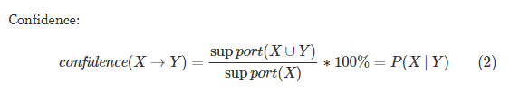
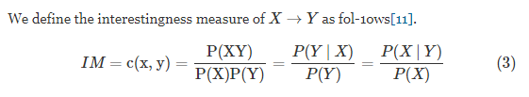
B. Association Rules and Interestingness Measure

Slide 11
B. Association Rules and Interestingness Measure
c(x,y) represents the correlation that between x and y.
If c(x,y)>1,x and y are positive correlation.
If c(x,y)<1,x and y are negative correlation.
If c(x,y)=1,x and y are independent of each other.

Slide 12
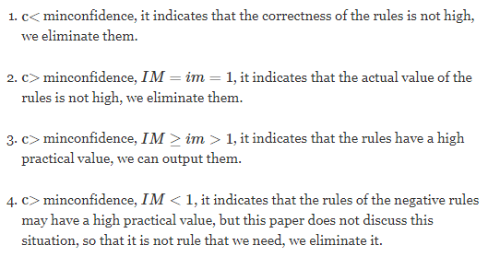
C. Algorithm
Confidence is denoted as C, and interestingness is denoted as IM.
Notes:
im = interestingness measure threshold.

Slide 13
Experiments and Analyses

Slide 14
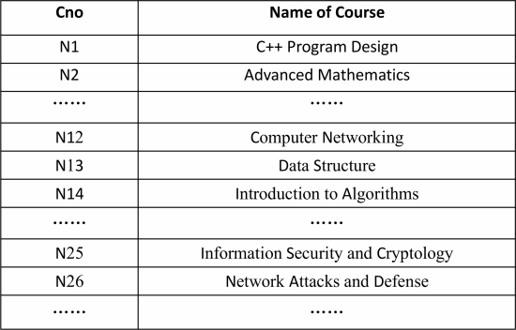
A. Data Processing
Each name of course corresponds to a code, the code of course is denoted by Cno.

Slide 15
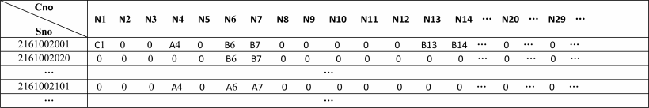
A. Data Processing
A : Score = 85~100
B : Score = 60~84
C : Score = 0~59

Slide 16
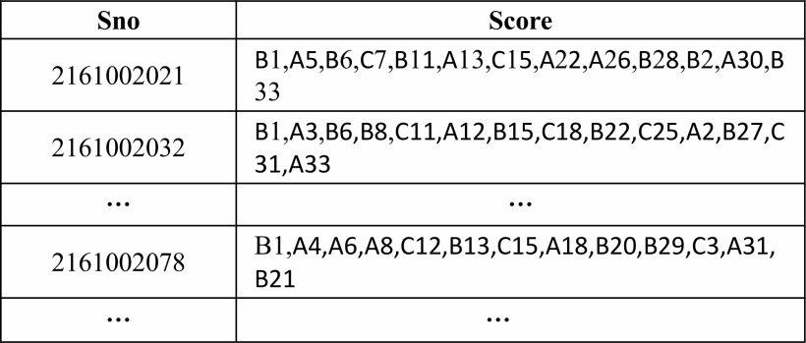
B. Experimental Settings
Notes:
Each student is a transaction, which contains the score of each student's course.

Slide 17
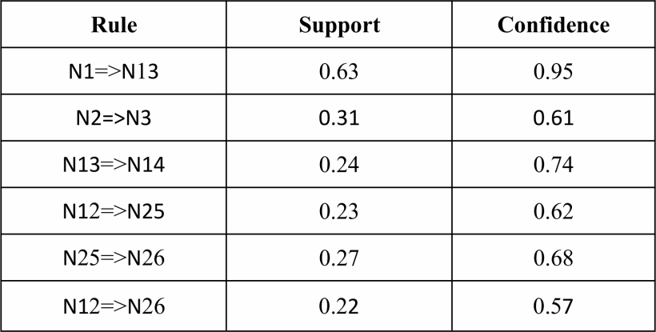

C. Experimental Results
N2 → A = 0.45
N3 → A = 0.35
Both → A = 0.12
Min_Support = 0.21
Min_Confidence = 0.56

Slide 18
C. Experimental Results
(1) N1→N13→N14
(2) N12→N25 or N12→N26
N25→N26
N12→N25→N26

Slide 19
Conclusions

Slide 20
Conclusions
In this paper, we apply the association rules and interestingness measure to the course selection system for students to recommend prerequisite courses of some courses, it can help students master the professional knowledge more easily and complete their studies more successfully.
With the increasing of data volume and the continuous development of data information, the application of association rules in data mining to the selection system in colleges and universities has gradually become a development trend, which can promote the further reform, improvement and development of education management.

Slide 21
Thanks for listening.
報告人：陳克威
日 期：2019/03/21

